Slide 1
Working with Databases
Chapter 11

Slide 2
Objectives
1
2
Databases and Web Development
Structured Query Language (SQL)
3
4
Database APIs
Managing a MySQL Database
5
6
Accessing MySQL in PHP
Case Study Schemas
7
7
Sample Database Techniques

Slide 3
Databases and Web Development
Section 1 of 7

Slide 4
Databases and Web Development
This chapter covers the core principles of relational Database Management Systems (DBMSs).
All database management systems are capable of
managing large amounts of data,
maintaining data integrity,
responding to many queries,
creating indexes and triggers, and more.
The term database can refer to both the software (i.e., to the DBMS) and to the data that is managed by the DBMS.

Slide 5
MySQL
We will be using MySQL
There are many other open source and proprietary relational DBMS, including:
PostgreSQL
Oracle Database
IBM DB2
Microsoft SQL Server
MySQL

Slide 6
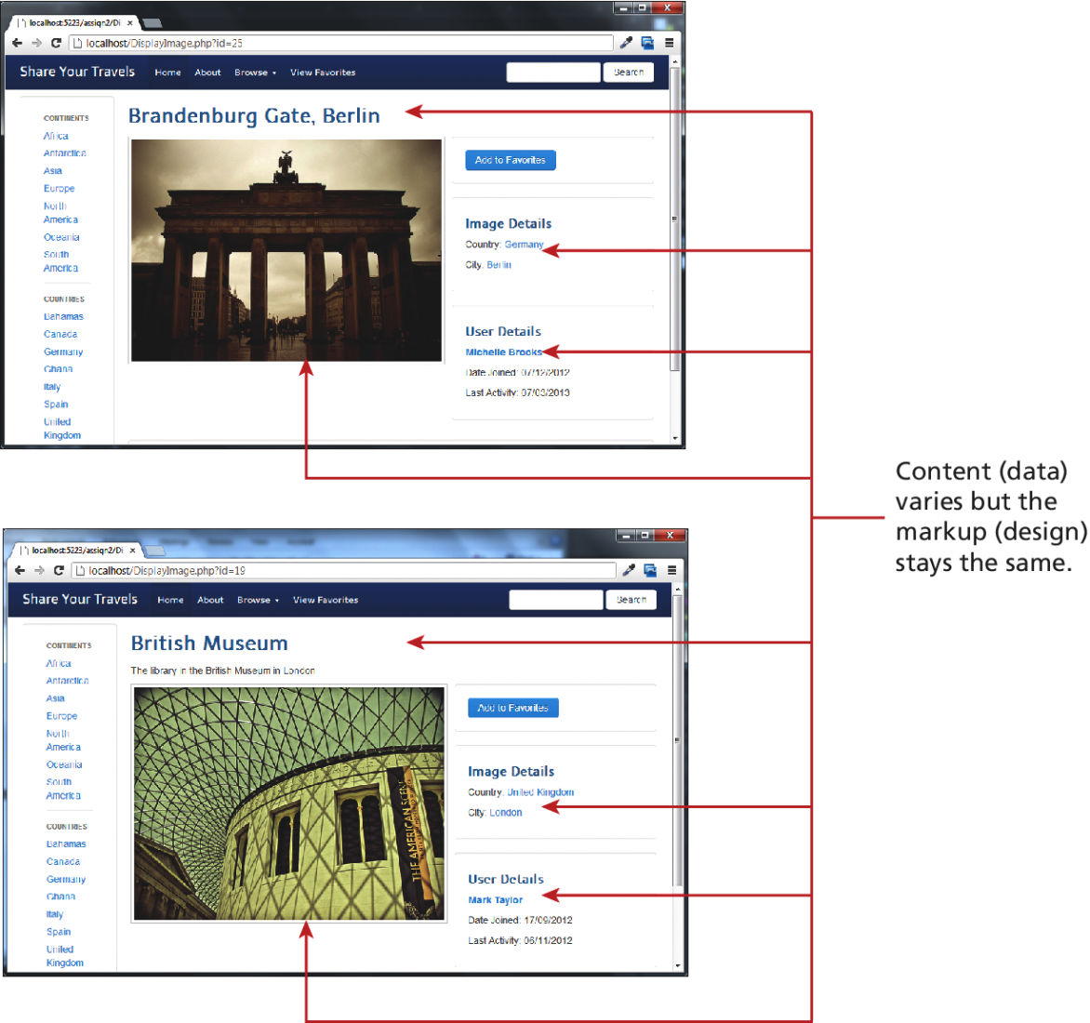
The Role of Databases
In Web Development
Databases provide a way to implement one of the most important software design principles:
one should separate that which varies from that which stays the same

Slide 7
Separate that which varies
That is, use a DB to store the content of pages.
The program (PHP) determines which data to display, often from information in the GET or POST query string, and then uses a database API to interact with the database
Although the same separation could be achieved by storing content in files on the server, databases offer intuitive and optimized systems that do far more than a file based design that would require custom-built reading, parsing, and writing functions.

Slide 8
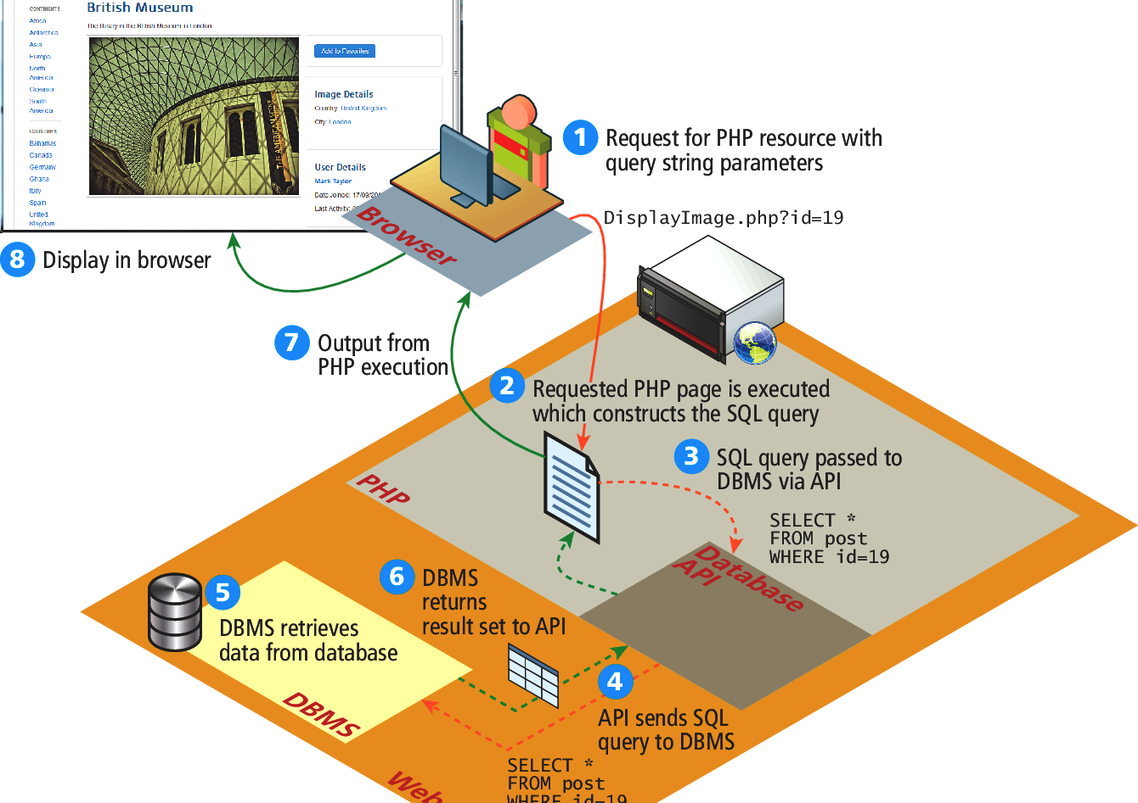
That Which Changes
Can be stored in the DB

Slide 9
Database Design
Tables
A database in a Relational DBMS is composed of one or more tables.
A table is a two-dimensional container for data that consists of records (rows);
Each record has the same number of columns, which are called fields, which contain the actual data.
Each table will have one special field called a primary key that is used to uniquely identify each record in a table.

Slide 10
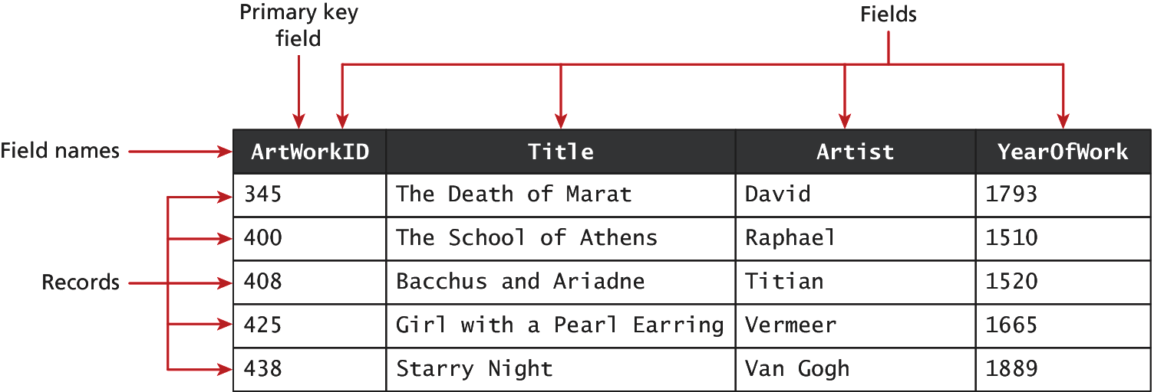
Tables in a Database
Illustrated example

Slide 11

Tables in a Database
Condensed Notation
As we discuss database tables and their design, it will be helpful to have a more condensed way to visually represent a table

Slide 12
Benefits of DBMS
Integrity
A database can enforce rules about what can be stored.
This provides data integrity and potentially can reduce the amount of data duplication.
This is partly achieved through the use of data types that are akin to those in a programming language.

Slide 13
Data types
Common Database Table Types
Type | Description
BIT | Represents a single bit for Boolean values. Also called BOOLEAN or BOOL.
BLOB | Represents a binary large object (which could, for example, be used to store an image).
CHAR(n) | A fixed number of characters (n = the number of characters) that are padded with spaces to fill the field.
DATE | Represents a date. There is also a TIME and DATETIME data types.
FLOAT | Represents a decimal number. There are also DOUBLE and DECIMAL data types.
INT | Represents a whole number. There is also a SMALLINT data type.
VARCHAR(n) | A variable number of characters (n = the maximum number of characters) with no space padding.

Slide 14
Benefits of DBMS
Integrity
One of the most important ways that data integrity is achieved in a database is by separating information about different things into different tables.
Two tables can be related together via foreign keys, which is a field that is the same as the primary key of another table

Slide 15
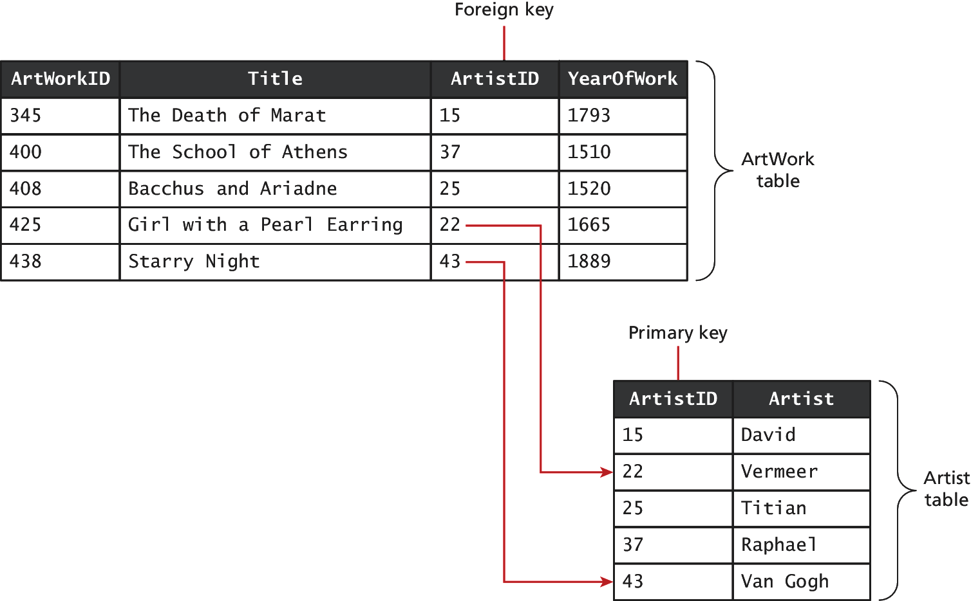
Relationships between Tables
Primary and Foreign Keys

Slide 16
Relationships between Tables
Different types
Tables that are linked via foreign keys are said to be in a relationship:
one-to-many relationship single record in Table A can have one or more matching records in Table B
many-to-many relationship Many-to-many relationships are usually implemented by using an intermediate table with two one-to-many relationships
One-to-one relationship Typically used for security or performance reasons. (Could be 1 table)

Slide 17
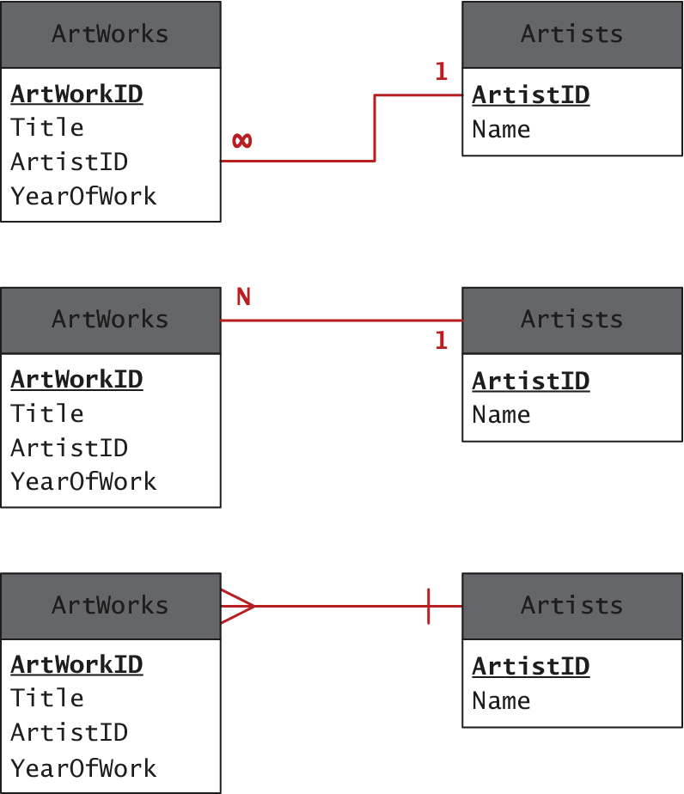
One to Many

Slide 18
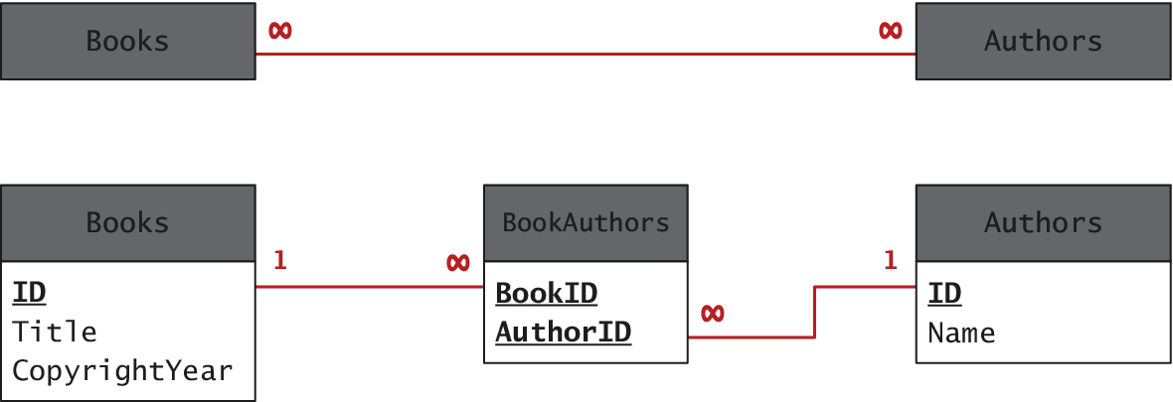
Many to Many
Usually using a intermediate table
Note that in this example, the two foreign keys in the intermediate table are combined to create a composite key

Slide 19
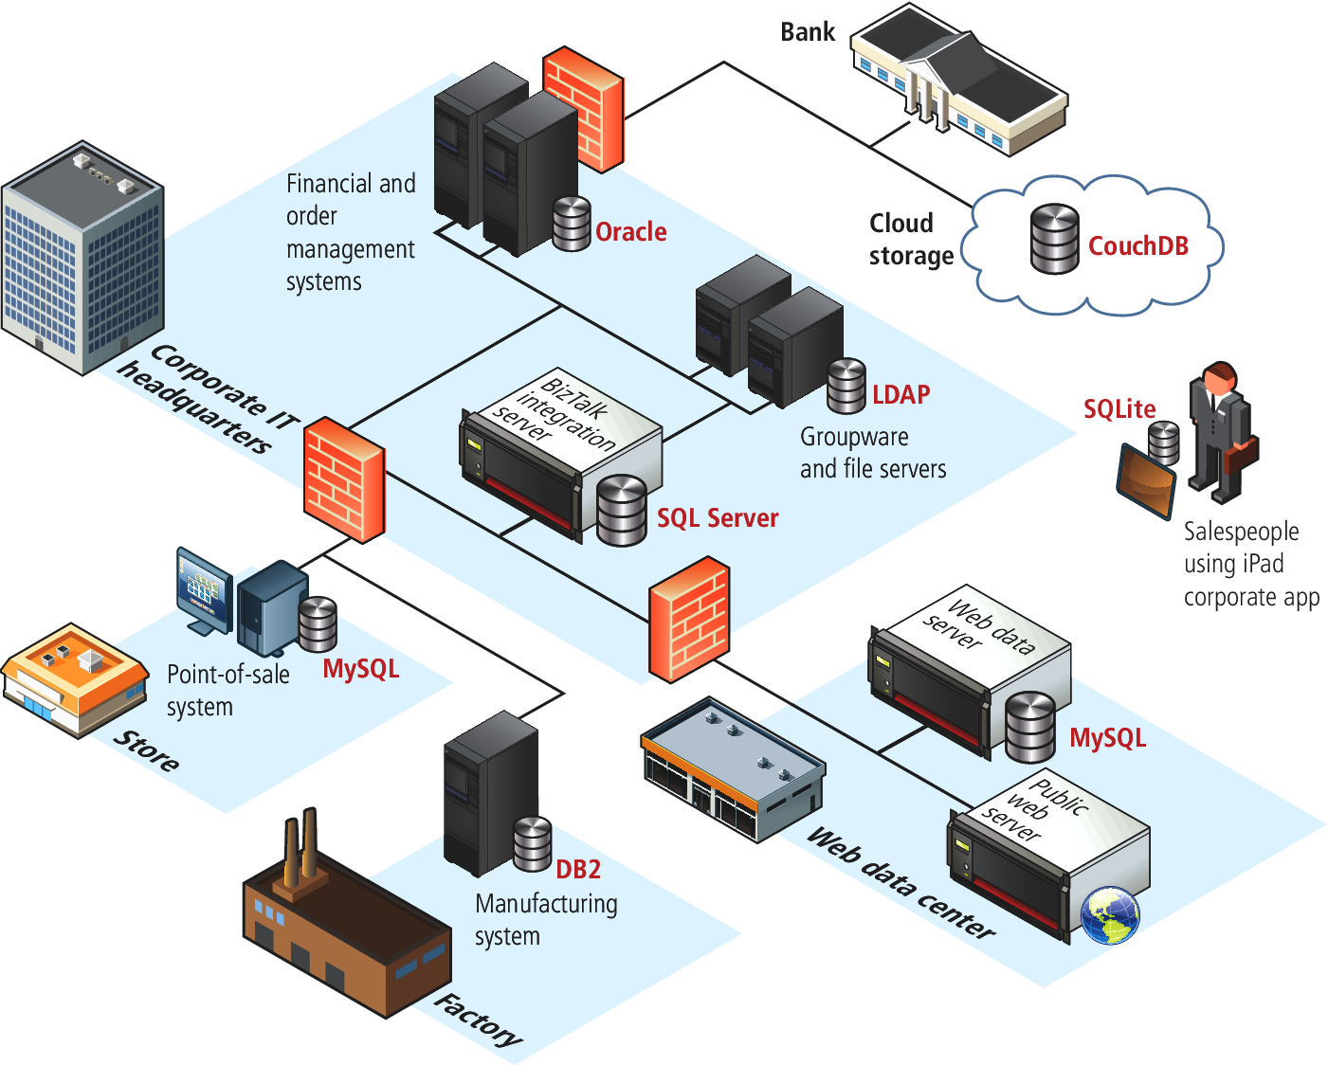
Database Options
The range of DBMS Usage in an Enterprise

Slide 20
Database Options
Other ways of using databases
SQLite a software library that typically is integrated directly within an application rather than running as a separate process like most DBMS.
No-SQL databases do not make use of SQL, are not relational in how they store data, and are optimized to retrieve data using simple key-value syntax similar to that used with associative arrays in PHP.
CouchDB , mongoDB, Hypertable, Cassandra, …

Slide 21
Structured Query Langugage (SQL)
Section 2 of 7

Slide 22
SQL
Pronounced sequel (or sss queue elle)
The Structured Query Language uses English Like Syntax to interact with the Database. Common SQL commands:
SELECT
INSERT
UPDATE
DELETE

Slide 23
SELECT
To retrieve data
The SELECT statement is used to retrieve data from the database.
The result of a SELECT statement is a block of data typically called a result set.
You must specify
what fields to retrieve and
what Table to retrieve from

Slide 24
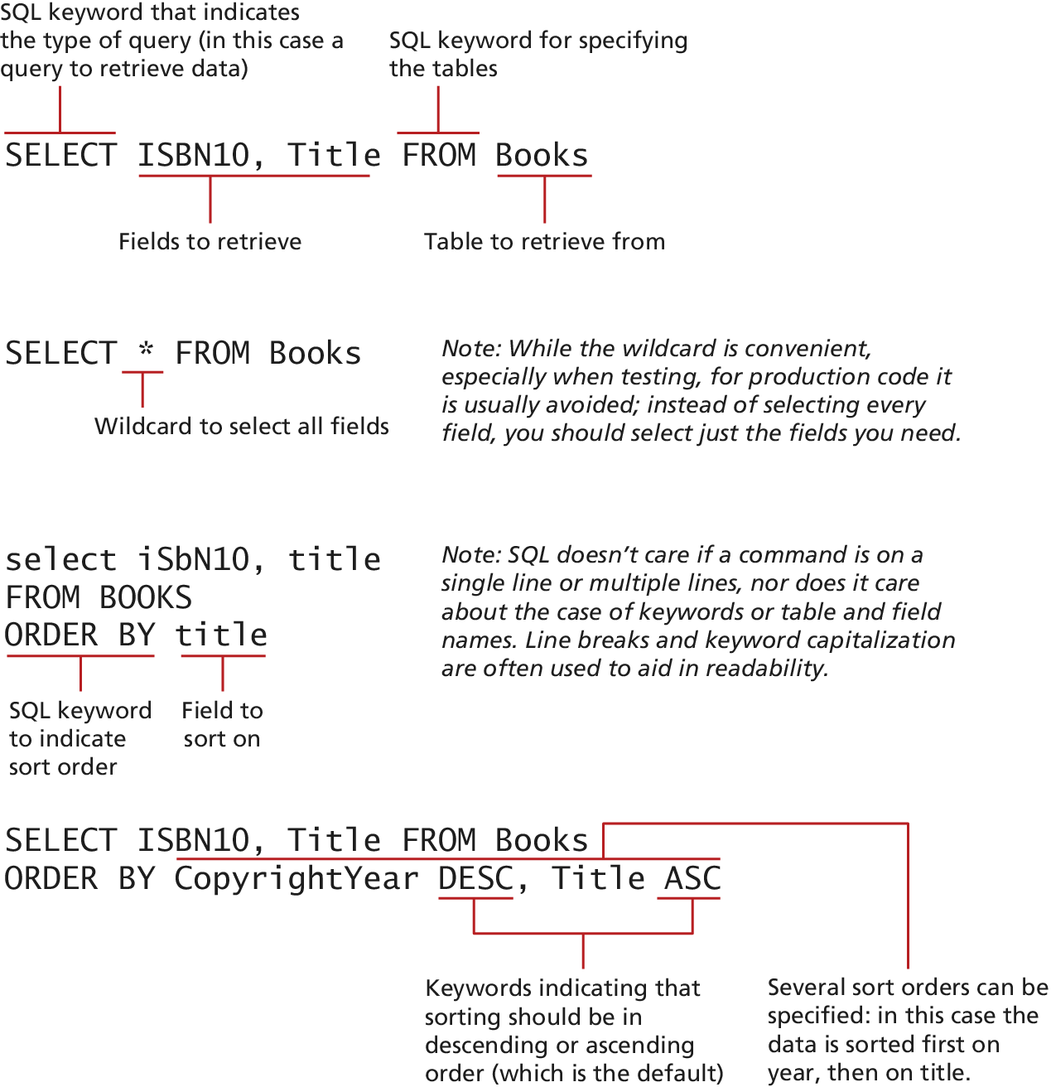
SELECT
To retrieve data

Slide 25
SELECT
Ordering results
To specify a certain order to the result set use the ORDER clause.
You Specify
the field to Sort on (or several), and
whether to sort in ascending or descending order.

Slide 26
SELECT
ORDER BY clause

Slide 27
SELECT
WHERE Clause
The Simple SELECT queries used so far retrieve all the records in the specified table.
Often we are not interested in retrieving all the records in a table but only a subset of the records.
This is accomplished via the WHERE clause, which can be added to any SELECT statement

Slide 28
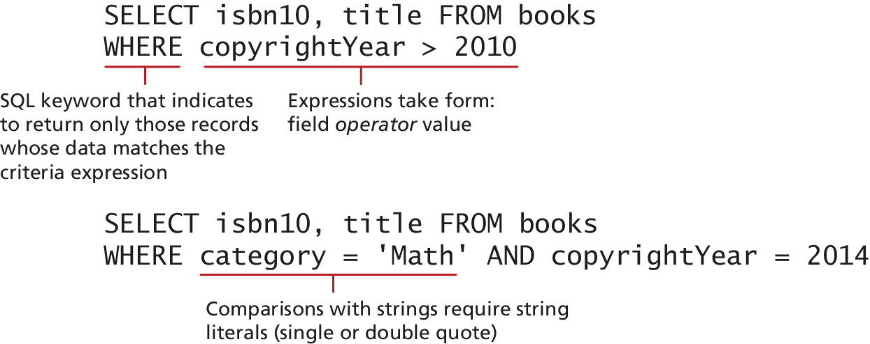
SELECT
WHERE Clause

Slide 29
SELECT
Advanced (but essential) techniques
Often we want to retrieve data from multiple tables. While we could do one query, and then do a second query using the data from the 1st query, that would be inefficient. Instead we can use the JOIN clause (we will discuss INNER JOIN)
When you don’t want every record in your table but instead want to perform some type of calculation on multiple records and then return the results. This requires using one or more aggregate functions such as SUM() or COUNT(); these are often used in conjunction with the GROUP BY keywords.

Slide 30
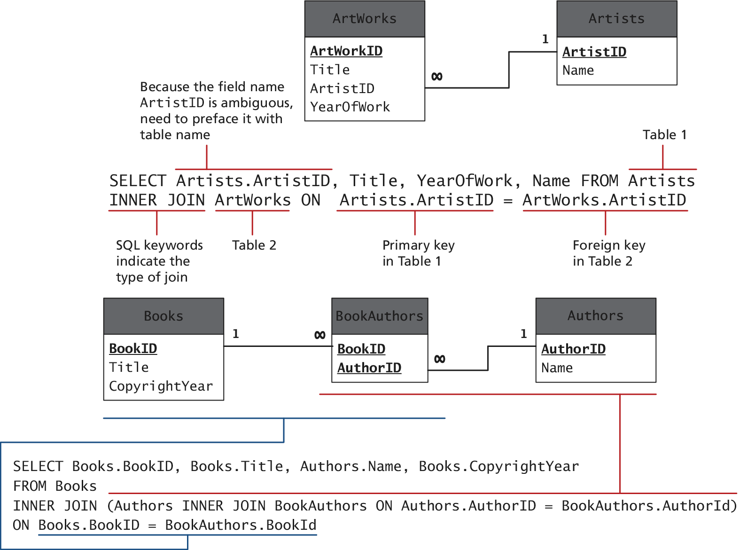
INNER JOIN
Still in a SELECT query

Slide 31
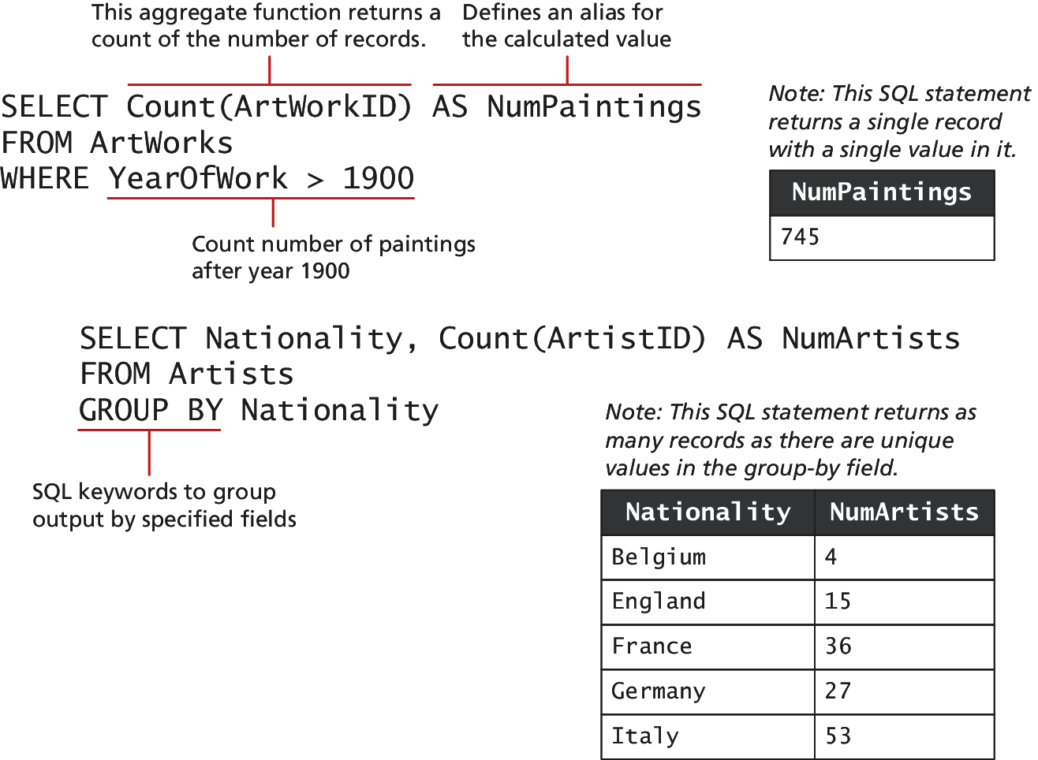
GROUP BY
Still in a SELECT query

Slide 32
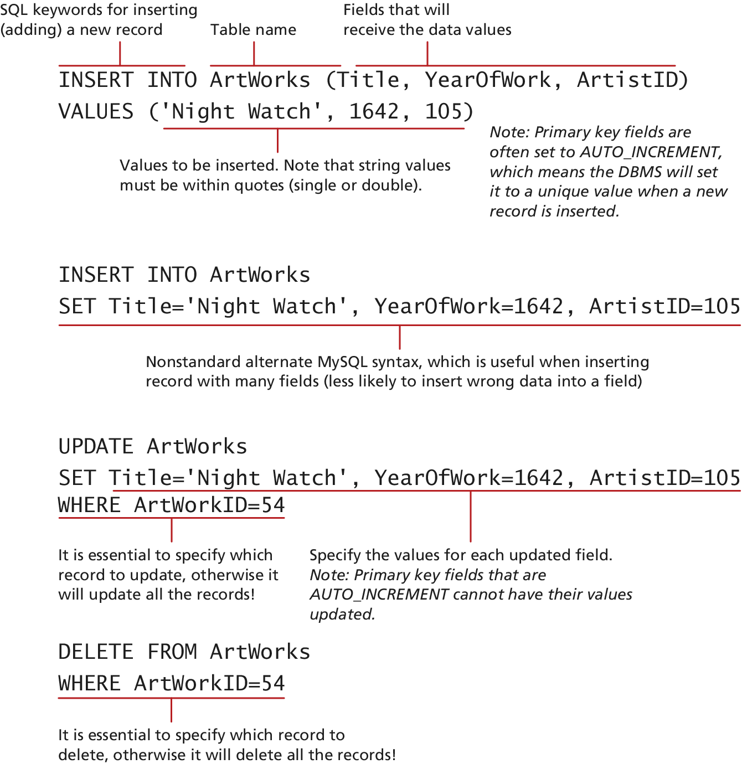
INSERT
Adding data in to the table

Slide 33
Update
Modify data in the table

Slide 34
Delete
Remove rows from the table

Slide 35
Transactions
An Advanced Topic.
Anytime one of your PHP pages makes changes to the database via an UPDATE, INSERT, or DELETE statement, you also need to be concerned with the possibility of failure.
A transaction refers to a sequence of steps that are treated as a single unit, and provide a way to gracefully handle errors and keep your data properly consistent when errors do occur.

Slide 36
Transactions
An Example
Imagine how a purchase would work in a web storefront. After the user has verified the shipping address, entered a credit card, and selected a shipping option and clicks the final Pay for Order button? Imagine that the following steps need to happen.
Write order records to the website database.
Check credit card service to see if payment is accepted.
If payment is accepted, send message to legacy ordering system.
Remove purchased item from warehouse inventory table and add it to the order shipped table.
Send message to shipping provider.

Slide 37
Transactions
An Example
At any step in this process, errors could occur. For instance:
The DBMS system could crash after writing the first order record but before the second order record could be written.
The credit card service could be unresponsive, or the credit card payment declined.
The legacy ordering system or inventory system or shipping provider system could be down.

Slide 38
Transactions
Multiple types
Local Transactions can be handled by the DBMS.
Distributed Transactions involve multiple hosts, several of which we may have no control over.
Distributed transactions are much more complicated than local transactions

Slide 39
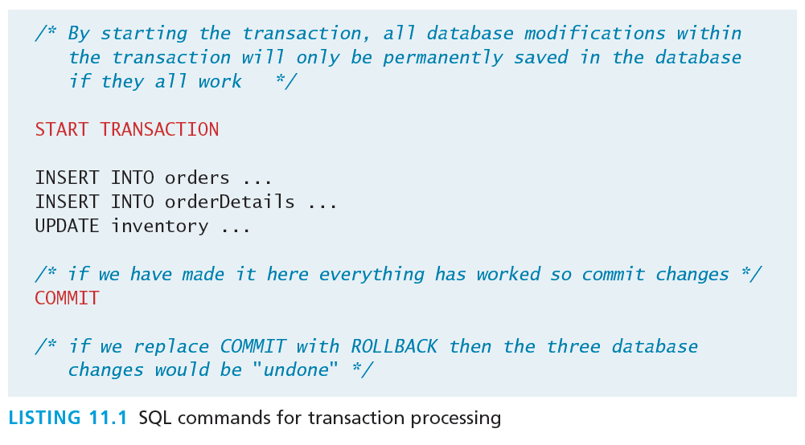
Local Transactions
The easy transactions
The SQL for transactions use the START TRANSACTION, COMMIT, and ROLLBACK commands

Slide 40
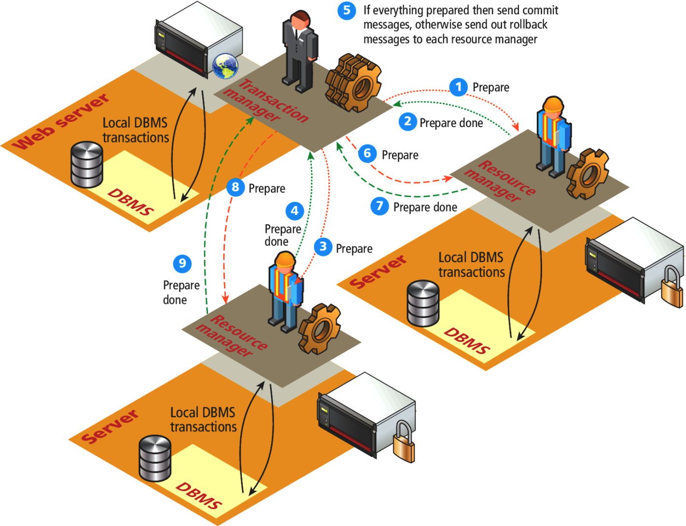
Distributed Transactions
Depends on which external systems…

Slide 41
Data Definition Statements
Data Manipulation Language features of SQL are what we typically describe in web development and include the SELECT, UPDATE, INSERT, and DELETE.
There is also a Data Definition Language (DDL) in SQL, which is used for creating tables, modifying the structure of a table, deleting tables, and creating and deleting databases. You may find yourself using them indirectly within something like the phpMyAdmin management tool, although a text syntax does exist for those interested.

Slide 42
Database Indexes
Efficiency
In large sets of data, searching for a particular record can take a long time.
Consider the worst-case scenario for searching where we compare our query against every single record. If there are n elements we say it takes O(n) time to do a search (we would say “Order of n”).
In comparison, a balanced binary tree data structure can be searched in O(log2 n) time.
N= 1,000,000
log2 (1000000) = 20 ← much faster

Slide 43
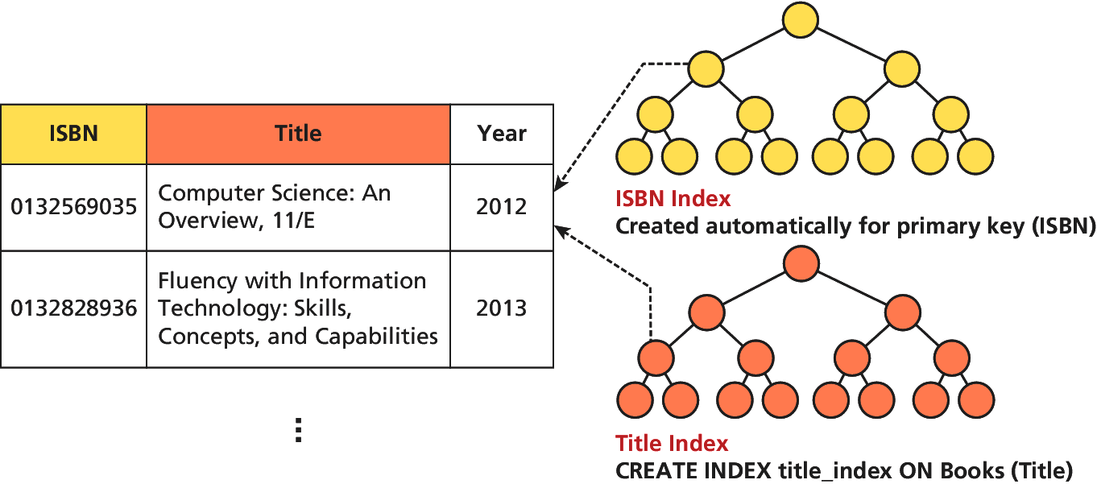
Database Indexes
Use balanced trees or other efficient structures
No matter which data structure is used, the application of that structure to ensure results are quickly accessible is called an index. Every node in the index has just that field, with a pointer to the full record (on disk)

Slide 44
Database Indexes
Syntax exists if you’re interested
Most database management tools allow for easy creation of indexes through the GUI without use of SQL commands.
The Index Creation Syntax is not normally used by web developers directly, and is not covered.

Slide 45
Database APIs
Section 3 of 7

Slide 46
API
Application Programming Interface
API stands for application programming interface and in general refers to the classes, methods, functions, and variables that your application uses to perform some task.
Some database APIs work only with a specific type of database; others are cross-platform and can work with multiple databases.

Slide 47
PHP MySQL APIs
There is more than 1
MySQL extension. This was the original extension to PHP for working with MySQL and has been replaced with the newer mysqli extension. This procedural API should now only be used with versions of MySQL older than 4.1.3. (At the time of writing, the current version of MySQL was 5.7.3.)
mysqli extension. The MySQL Improved extension takes advantage of features of versions of MySQL after 4.1.3. This extension provides both a procedural and an object-oriented approach. This extension also supports most of the latest features of MySQL.
PHP data objects (PDOs). This object-oriented API has been available since PHP 5.1 and provides an abstraction layer (i.e., a set of classes that hide the implementation details for some set of functionality) that with the appropriate drivers can be used with any database, and not just MySQL databases. However, it is not able to make use of all the latest features of MySQL.

Slide 48
We will show how to do some of the most common database operations using the procedural mysqli extension as well as the object-oriented PDO.
As the chapter (and book) proceed, we will standardize on the object-oriented, database-independent PDO approach.

Slide 49
ManaginG a MySQL Database
Section 4 of 7

Slide 50
How do you access the DBMS
So, so many ways
Although you will eventually be able to manipulate the database from your PHP code, there are some routine maintenance operations that do not warrant custom code. Tools include:
Command Line Interface
phpMyAdmin
MySQLWorkbench

Slide 51
Command Line Interface
Oldie but a goodie.
The MySQL command-line interface is the most difficult to master. The value of this particular management tool is its low bandwidth and near ubiquitous presence on Linux machines.
To launch an interactive MySQL command-line session, you must specify the host, username, and database name to connect to as shown below:
mysql -h 192.168.1.14 -u bookUser –p
Once inside of a session, you may enter any SQL query, terminated with asemicolon (;)

Slide 52
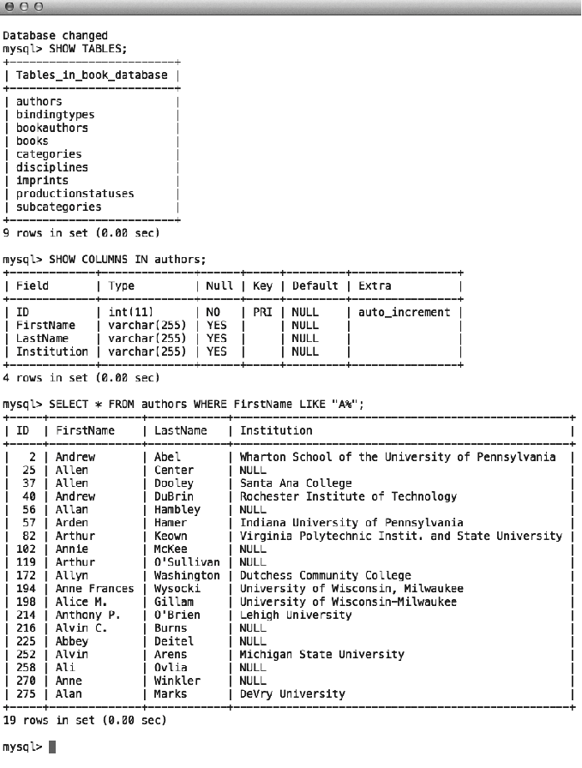
Command Line Interface
Oldie but a goodie.

Slide 53
Command Line Interface
I bet you’ll use it oneday…
In addition to the interactive prompt, the command line can be used to import and export entire databases or run a batch of SQL commands from a file.
To import commands from a file called commands.sql, for example, we would use the < operation:
mysql –h 192.168.1.14 –u bookUser –p < commands.sql
Although GUI tools allow this as well, the CLI can be integrated into automated scripts to aid with mirroring, backup, and recovery.

Slide 54
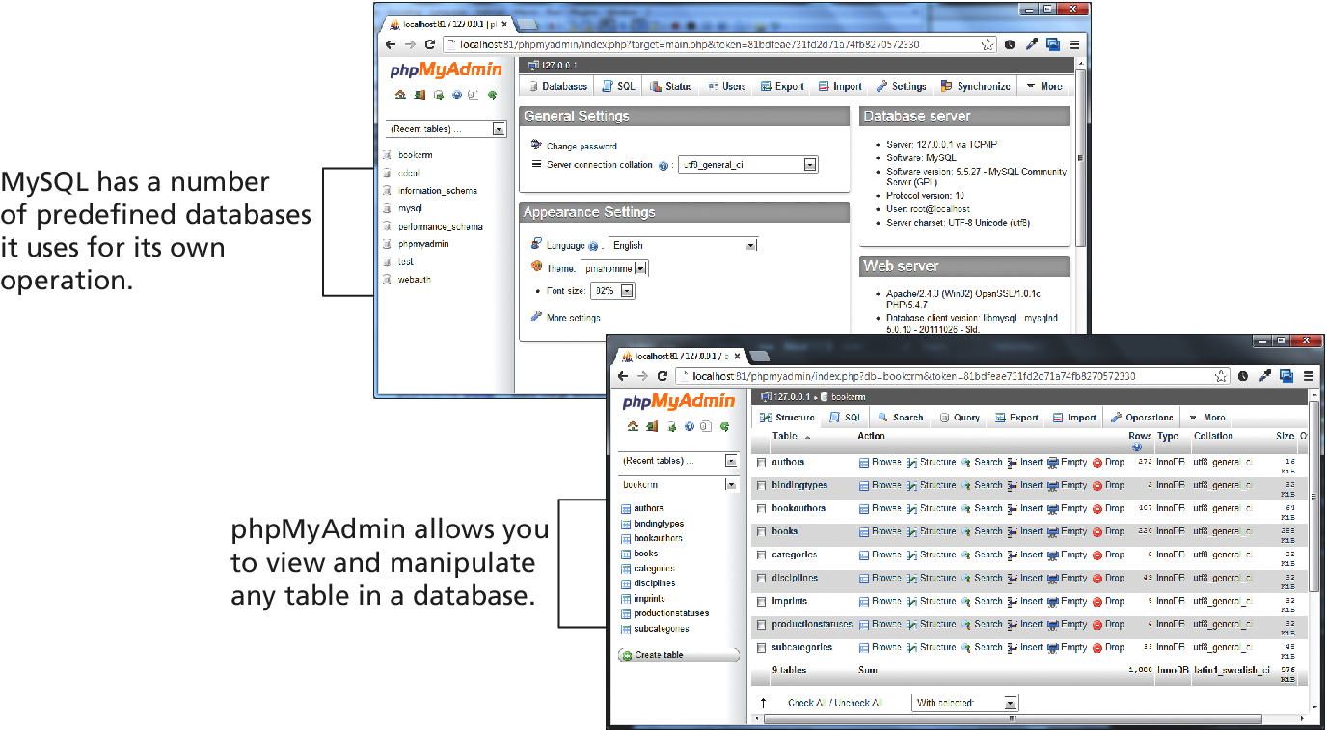
phpMyAdmin
Will even generate PHP code
A popular web-based front-end (written in PHP) called phpMyAdmin allows developers to access management tools through a web portal.

Slide 55
MySQL Workbench
Powerful design tools
The MySQL Workbench is a free tool from Oracle to work with MySQL databases.

Slide 56
Accessing MySQl in PHP
Section 5 of 7

Slide 57
Database Connection Algorithm
No matter what API you use, the basic database connection algorithm is the same:
Connect to the database.
Handle connection errors.
Execute the SQL query.
Process the results.
Free resources and close connection.

Slide 58
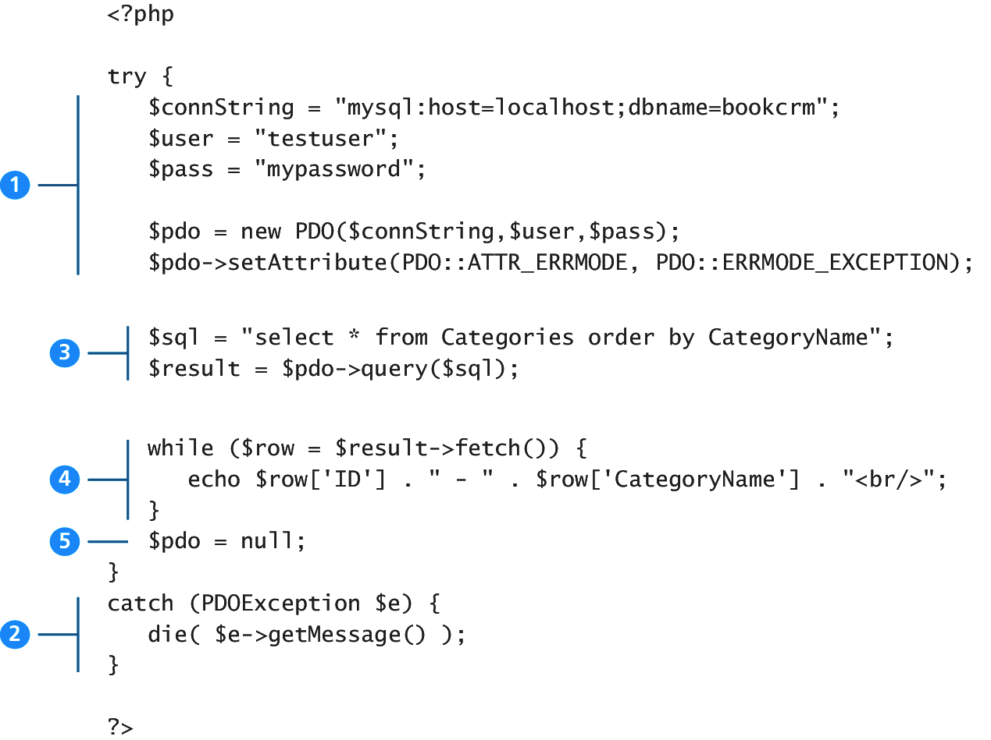
Database Connection Algorithm
An illustration through example

Slide 59
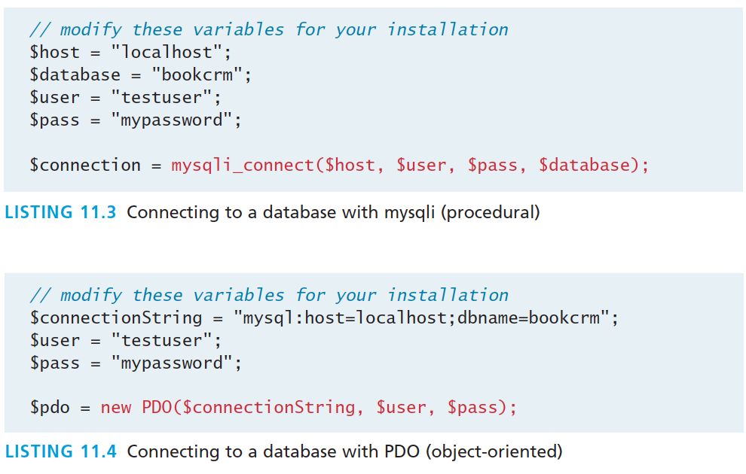
Database Connection Algorithm
An illustration through example

Slide 60
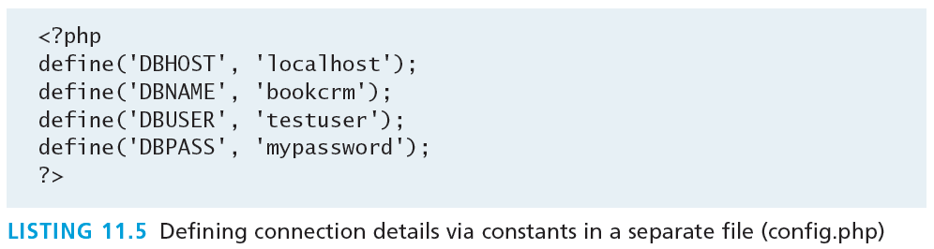
Storing Connection Details
Hard-coding the database connection details in your code is not ideal.
Connection details almost always change as a site moves from development, to testing, to production.
We should move these connection details out of our connection code and place it in some central location.

Slide 61
Handling Connection Errors
We need to handle potential connection errors in our code.
Procedural mysqli techniques use conditional (if...else) statements on the returned object from the connection attempt.
The PDO technique uses try-catch which relies on thrown exceptions when an error occurrs.

Slide 62
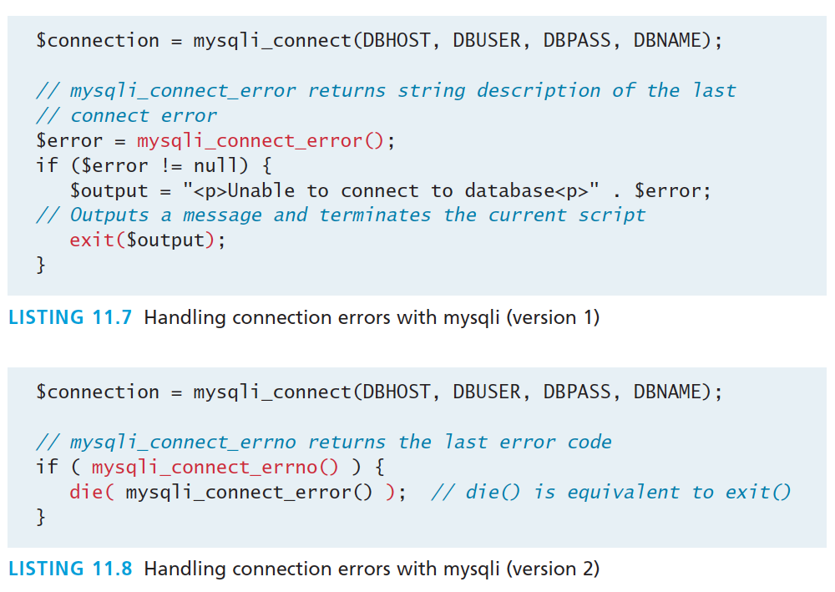
Handling Connection Errors
Procedural Approach

Slide 63
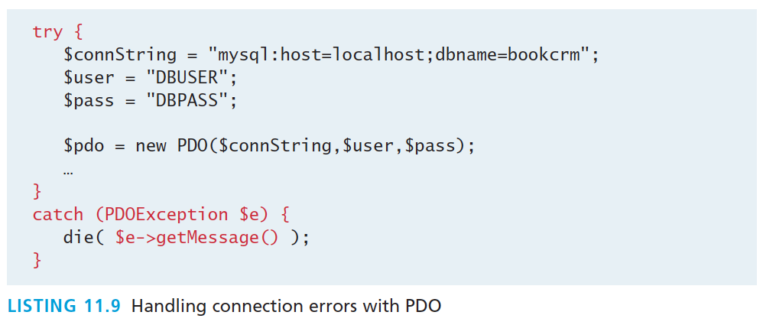
Handling Connection Errors
Object-Oriented PDO with try-catch
In addition PDO has 3 different error modes, that allow you to control when errors are thrown.

Slide 64
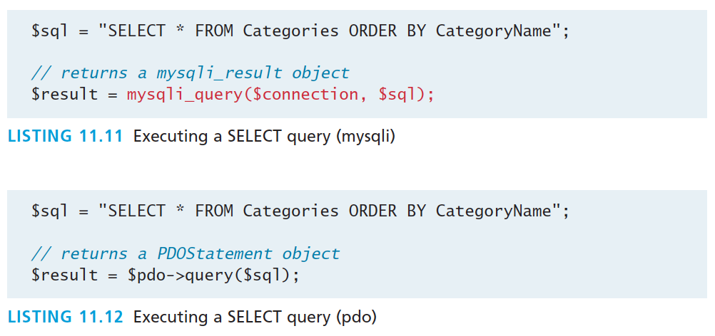
Execute the Query
Procedural and Object-Oriented
Both return a result set, which is a type of cursor or pointer to the returned data

Slide 65
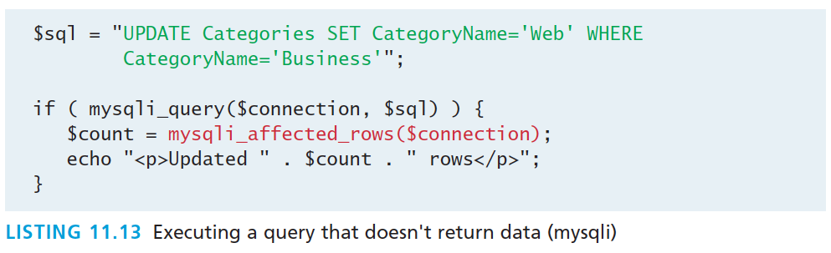
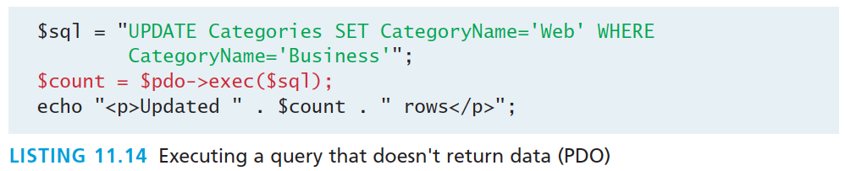
Queries that don’t return data
Procedural and Object-Oriented

Slide 66
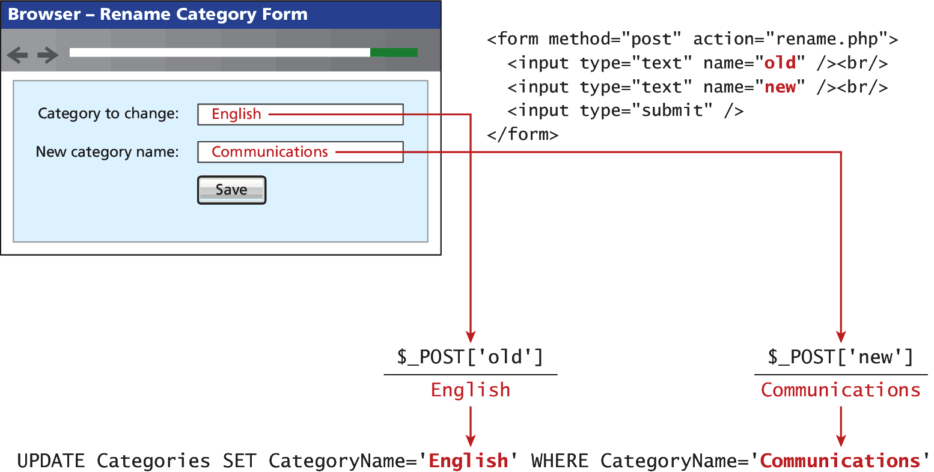
Integrating User Data
Say, using an HTML form posted to the PHP script

Slide 67
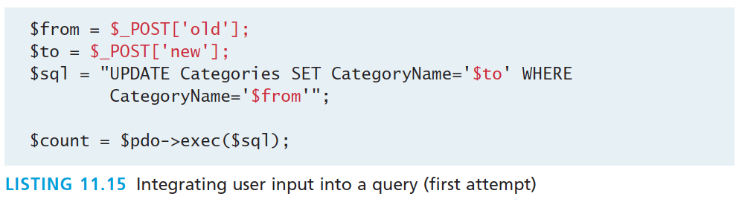
Integrating User Data
Not everyone is nice.
While this does work, it opens our site to one of the most common web security attacks, the SQL injection attack.

Slide 68
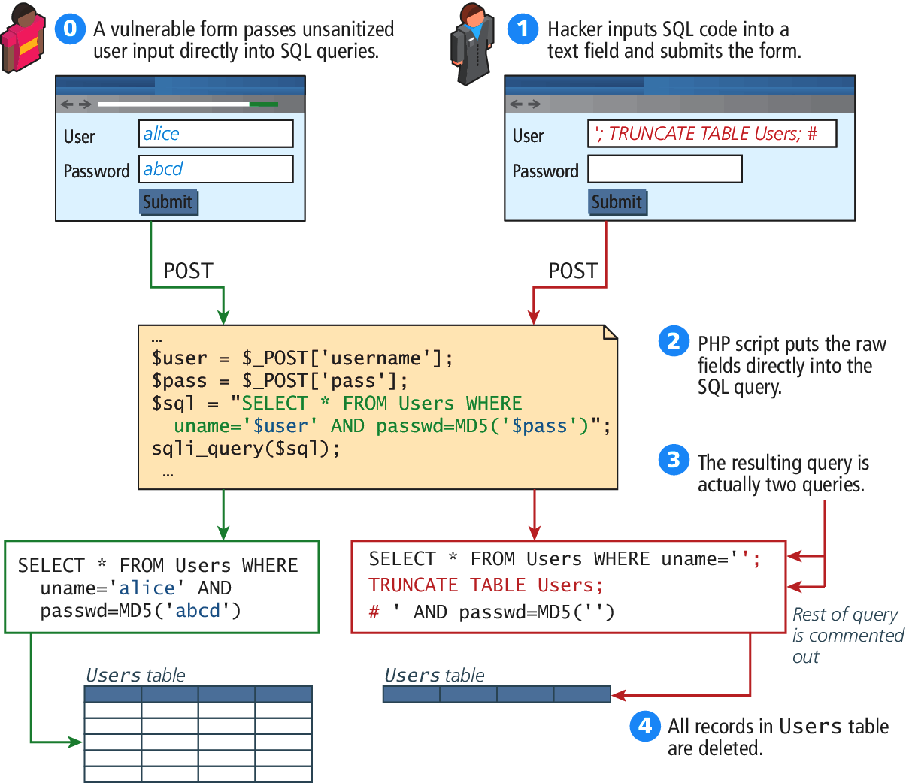
SQL Injection Illustration
From Chapter 16

Slide 69
Defend against attack
Distrust user input
The SQL injection class of attack can be protected against by
Sanitizing user input
Using Prepared Statements

Slide 70
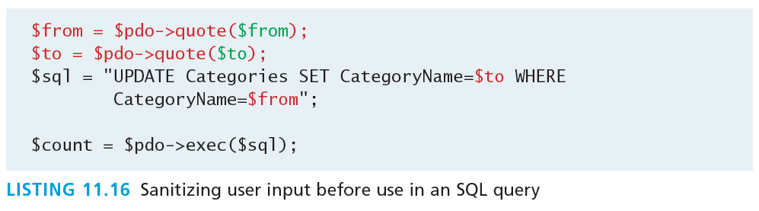
Sanitize User Input
Quick and easy
Each database system has functions to remove any special characters from a desired piece of text. In MySQL, user inputs can be sanitized in PHP using the mysqli_real_escape_string() method or, if using PDO, the quote() method

Slide 71
Prepared Statements
Better in general
A prepared statement is actually a way to improve performance for queries that need to be executed multiple times. When MySQL creates a prepared statement, it does something akin to a compiler in that it optimizes it so that it has superior performance for multiple requests. It also integrates sanitization into each user input automatically, thereby protecting us from SQL injection.

Slide 72
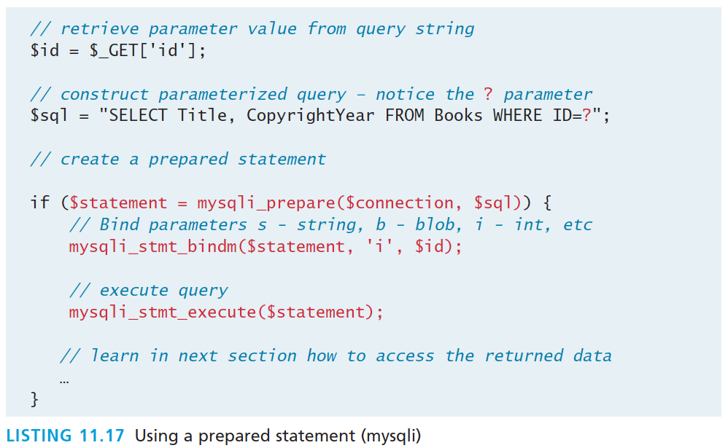
Prepared Statements
mysqli

Slide 73
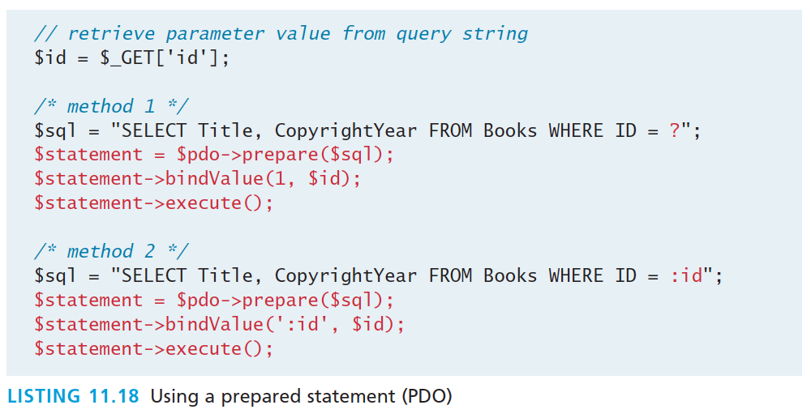
Prepared Statements
PDO

Slide 74
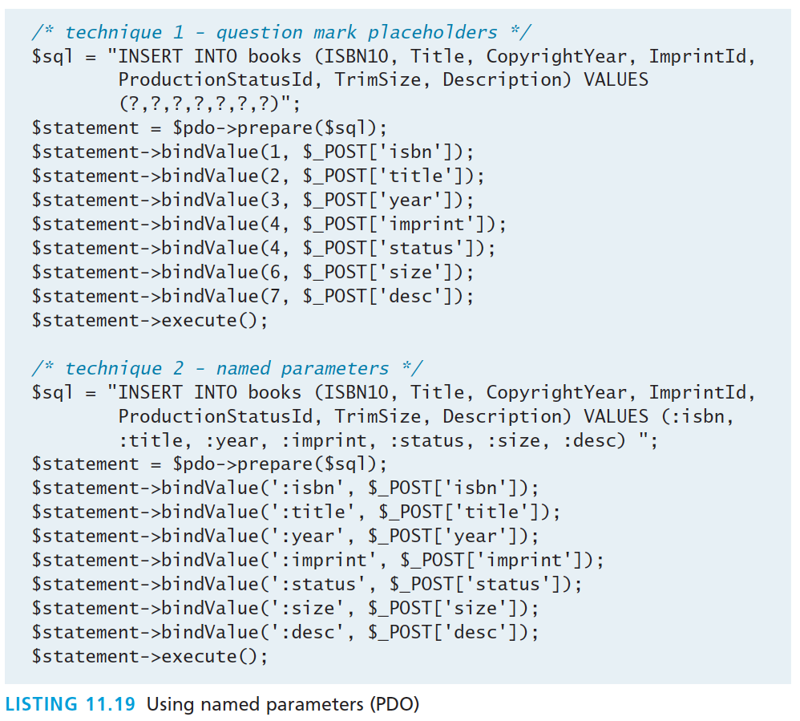
Prepared Statements
Comparison of two techniques

Slide 75
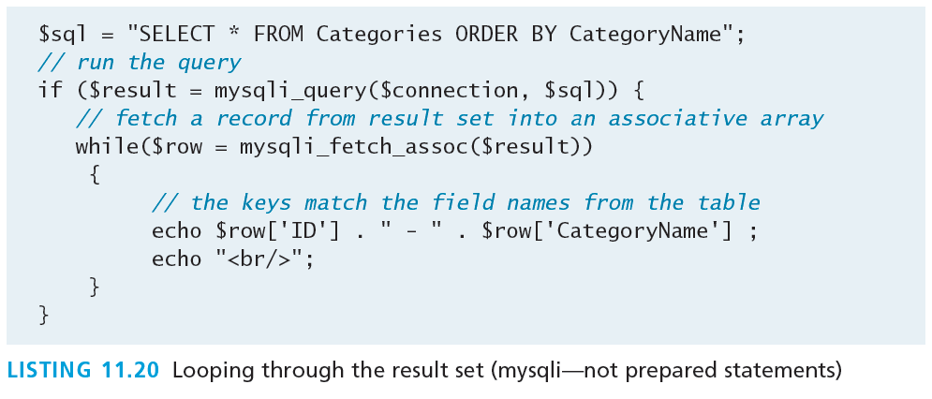
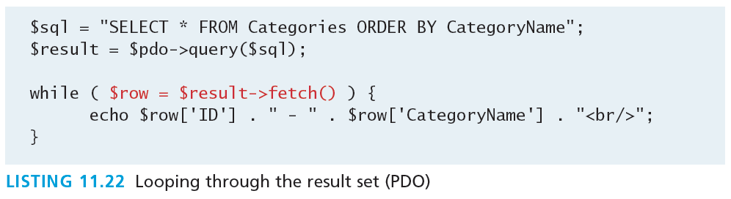
Process Query Results
mysqli

Slide 76
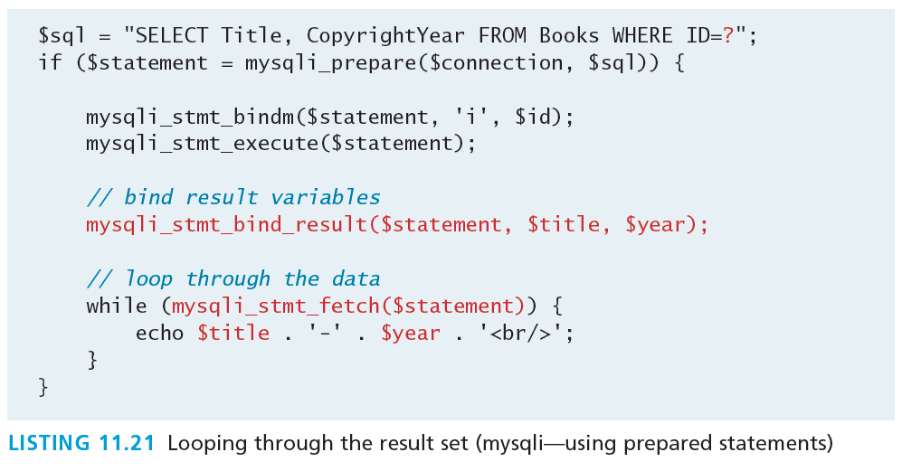
Process Query Results
Mysqli – using prepared statements

Slide 77
Fetch into an object
Instead of an array
Consider the following (very simplified) class:
class Book {
public $id; public $title; public $copyrightYear; public $description; }

Slide 78
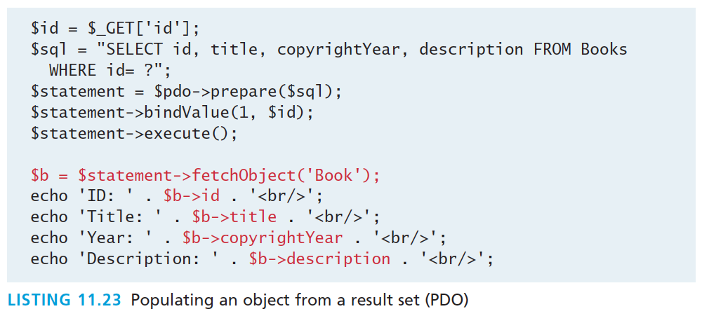
Fetch into an object
Instead of an array
The property names must match exactly (including the case) the field names in the table(s) in the query

Slide 79
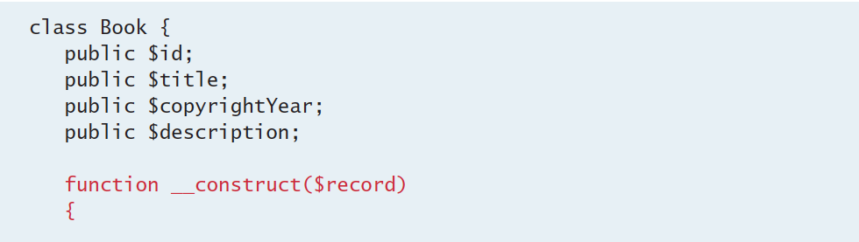
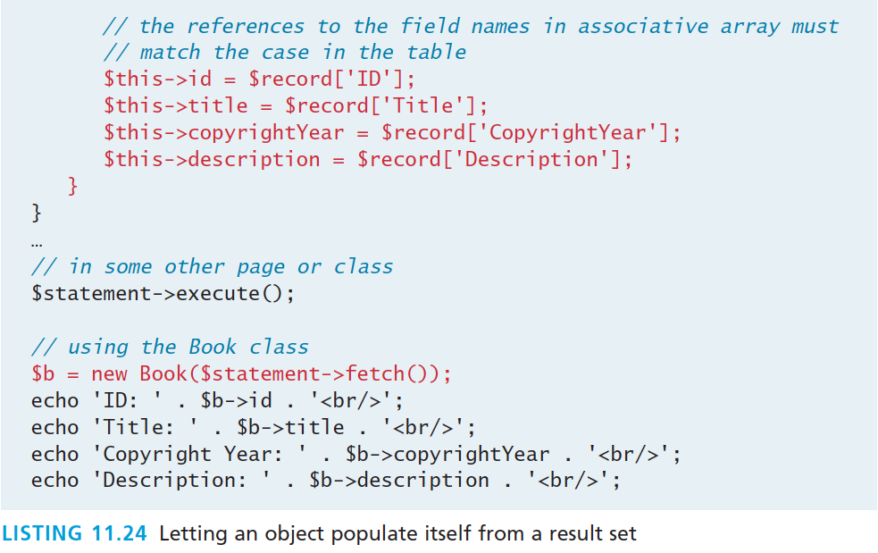
Fetch into an object
A more flexible example, where class names needn’t match DB fields

Slide 80
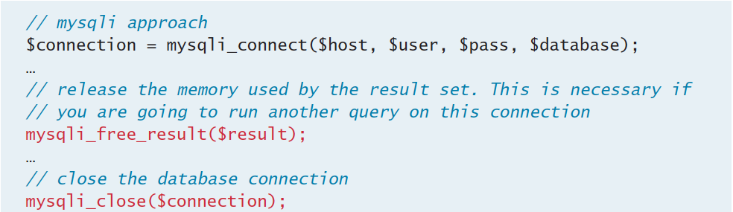
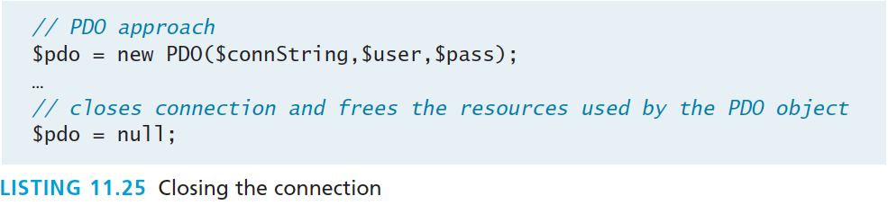
Freeing Resources
And closing the connection

Slide 81
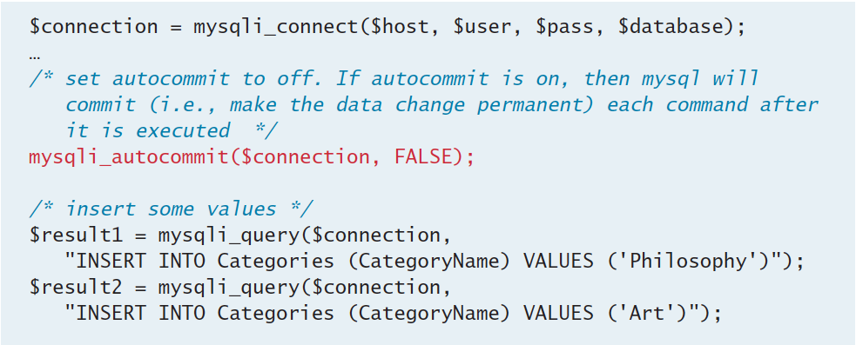
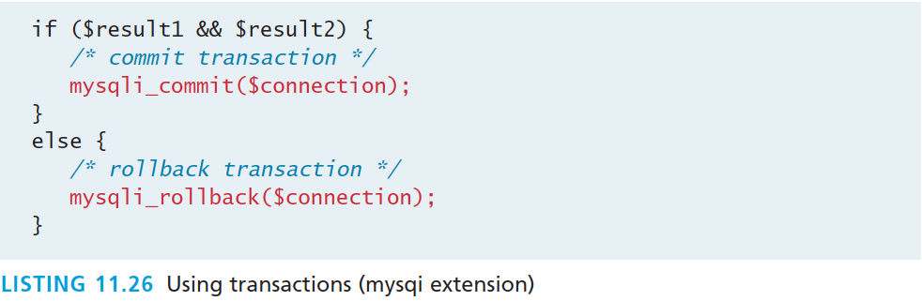
Using Transactions
mysqli

Slide 82
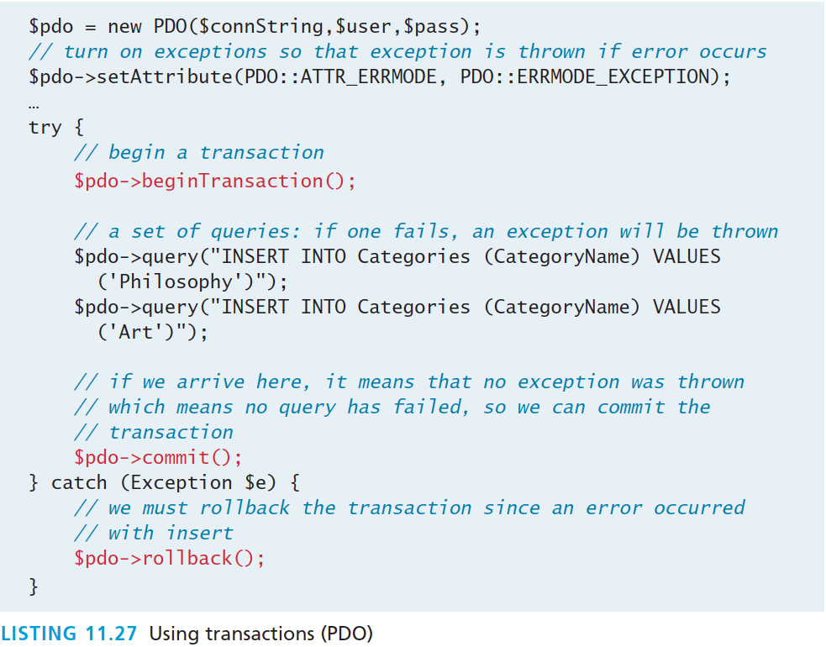
Using Transactions
PDO

Slide 83
Case Study Schemas
Section 6 of 7

Slide 84
Art Database

Slide 85
Book CRM Database
Customer Relationship Management

Slide 86
Travel Photo Sharing Database

Slide 87
Sample Database Techniques
Section 7 of 7

Slide 88
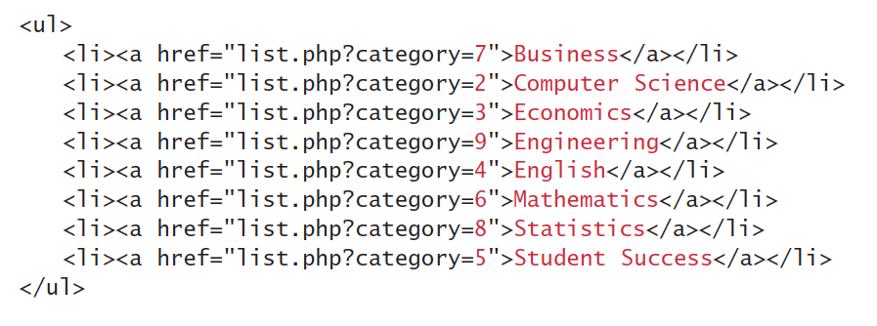
Display a list of Links
One of the most common database tasks in PHP is to display a list of links (i.e., a series of <li> elements within a <ul>).

Slide 89
Display a list of Links
At its simplest, the code would look something like the following:
$sql = "SELECT * FROM Categories ORDER BY CategoryName”; $result = $pdo->query($sql); while ($row = $result->fetch()) { echo '<li>’; echo '<a href="list.php?category=' . $row['ID'] . '">’; echo $row['CategoryName']; echo '</a>’; echo '</li>’; }

Slide 90
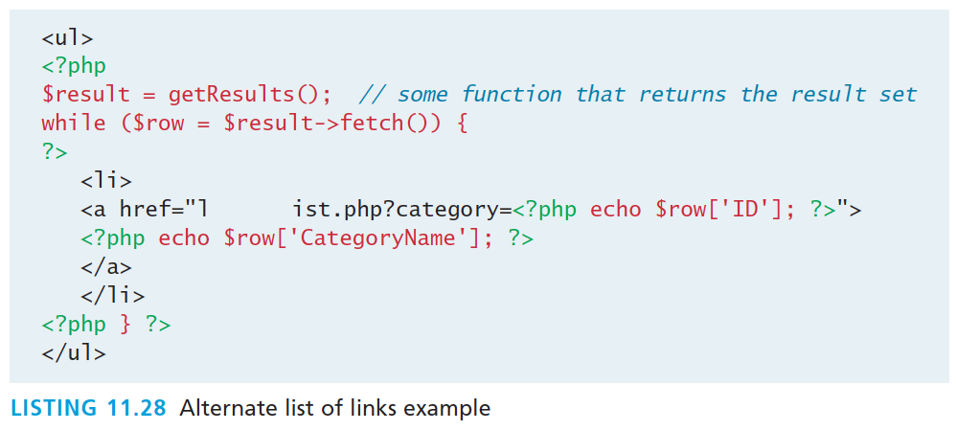
Display a list of Links
More maintainable version

Slide 91
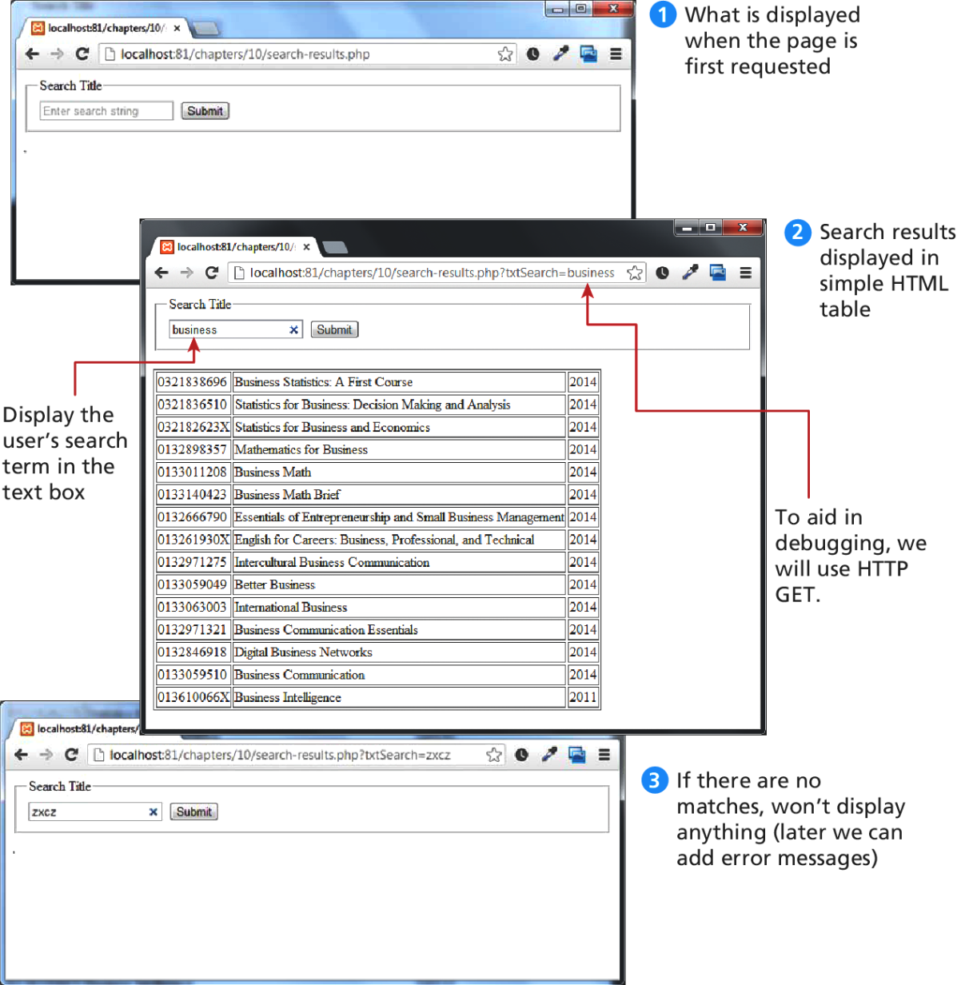
Search and Results Page
Visual of search box, results page, and no results page

Slide 92
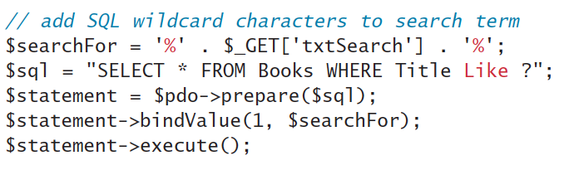
Search and Results Page
In this example, we will assume that there is a text box with the name txtSearch in which the user enters a search string along with a Submit button.
The data that we will filter is the Book table; we will display any book records that contain the user-entered text in the Title field.

Slide 93
Search and Results Page
To redisplay the search term we will add code like:
<input type="search” name="txtSearch” placeholder="Enter search string” value="<?php echo $_GET['txtSearch']; ?>" />
To where we generate the form. Unfortunately…

Slide 94
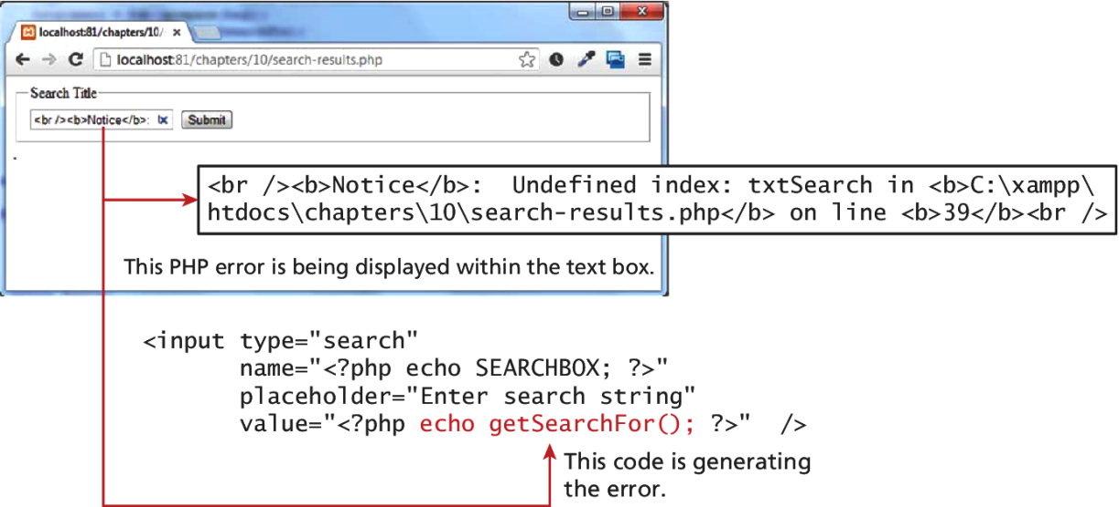
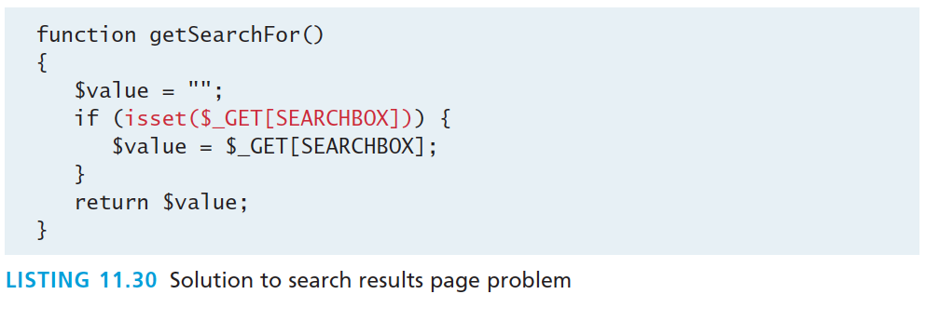
Search and Results Page
Problem to be solved

Slide 95
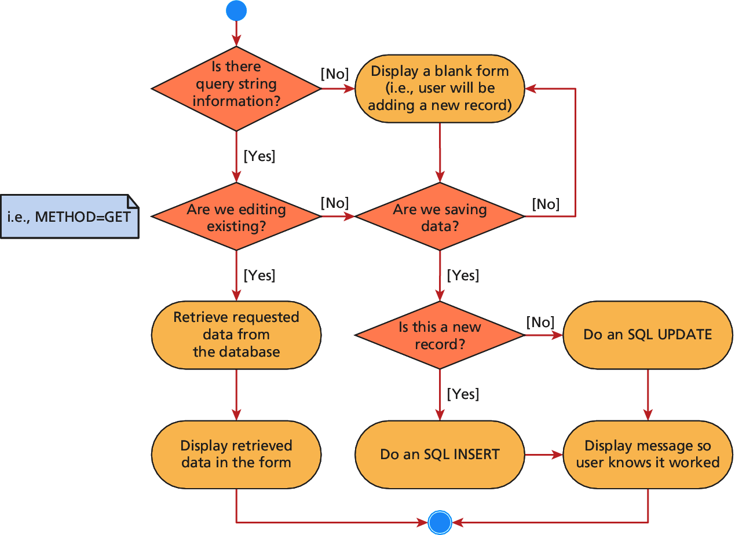
Editing a Record

Slide 96

Editing a Record

Slide 97
Files in the Database
There are two ways of storing files in a database:
Storing file location in the database, and storing the file on the server’s filesystem
Storing the file itself in the database in the form of a binary BLOB

Slide 98

Files in the Database
As a file Location

Slide 99

Files in the Database
As a BLOB

Slide 100


Files in the Database
Storing and retrieving BLOBs

Slide 101
Files in the Database
Storing and retrieving BLOBs
Listing 11.36 can then be integrated into HTML image tags by pointing the src attribute to our script
<img src="/images/Author280.jpg"/>
Would now reference a dynamic PHP script like:
<img src="getImage.php?id=280"/>

Slide 102

Files in the Database
HTTP headers matter
The same file output with correct and incorrect headers is interpreted differently by the browser

Slide 103
What You’ve Learned
1
2
Databases and Web Development
Structured Query Language (SQL)
3
4
Database APIs
Managing a MySQL Database
5
6
Accessing MySQL in PHP
Case Study Schemas
7
7
Sample Database Techniques

